Slide 1

Drug Recommendation System based on Sentiment Analysis of Drug Reviews using Machine Learning
Guided by
Dr.S.Alagumuthukrishnan
Associate Professor
Department of CSE
Team Members:
K.Bhanu Prasad(19R01A0531)
M.Chaitanya Kumar(19R01A0537)
S.Rajkumar(19R01A0550)
S.Sriram(19R01A0553)

Slide 2
INTRODUCTION
With the number of corona virus cases growing exponentially, the nations are facing a shortage of doctors, particularly in rural areas where the quantity of specialists is less compared to urban areas.
A doctor takes roughly 6 to 12 years to procure the necessary qualifications.
Thus, the number of doctors can’t be expanded quickly in a short time frame.
A Telemedicine framework ought to be energized as far as possible in this difficult time .
Clinical blunders are very regular nowadays.
Over 200 thousand individuals in China and 100 thousand in the USA are affected every year because of prescription mistakes.
Over 40% medicine, specialists make mistakes while prescribing since specialists compose the solution as referenced by their knowledge, which is very restricted .

Slide 3
EXISTING SYSTEM
TF-IDF
Word2Vec
Manual Feature Analysis
Existing systems uses only uses Logistic regression and SVM methodologies for predicting the given data.

Slide 4
DRAWBACK OF EXISTING SYSTEM

Slide 5

LITERATURE-STUDY
With a sharp increment in AI advancement, there has been an exertion in applying machine learning and deep learning strategies to recommender frameworks.
These days, recommender frameworks are very regular in the travel industry, e-commerce, restaurant, and so forth.
Unfortunately, there are a limited number of studies available in the field of drug proposal framework utilizing sentiment analysis on the grounds that the medication reviews are substantially more intricate to analyze as it incorporates clinical wordings like infection names, reactions, a synthetic names that used in the production of the drug
The study presents GalenOWL, a semantic-empowered online framework, to help specialists discover details on the medications

Slide 6
PROPOSED SYSTEMS
The dataset used in this research is Drug Review Dataset (Drugs.com) taken from the UCI ML repository .
This dataset contains six attributes, name of drug used (text), review (text) of a patient, condition (text) of a patient, useful count (numerical) which suggest the number of individuals who found the review helpful, date (date) of review entry, and a 10-star patient rating (numerical) determining overall patient contentment. It contains a total of 215063 instances.
Data Cleaning and Visualisation
Feature Extraction
Train Test Split

Slide 7
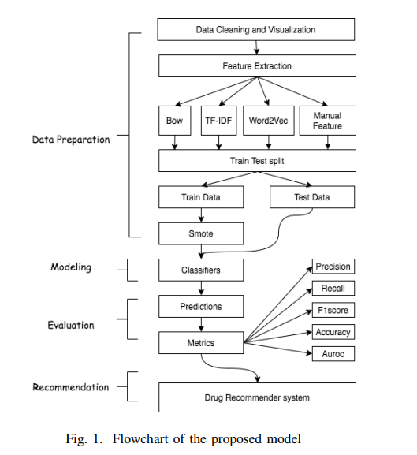

Slide 8
SOFTWARE HARDWARE DESCRIPTION
Python libraries:
Sklearn
Pandas
Word Cloud
Xampp
Apache Server
MySql Server
Django

Slide 9
MODULES
Service Provider:
In this module, the Service Provider has to login by using valid user name and password. After login successful he can do some operations such as
View and Authorize Users:
In this module, the admin can view the list of users who all registered.
In this, the admin can view the user’s details such as, user name, email, address and admin authorizes the users.
Remote User:
In this module, there are n numbers of users are present. User should register before doing any operations. Once user registers, their details will be stored to the database.

Slide 10
REFERENCES
1.Telemedicine, https://www.mohfw.gov.in/pdf/Telemedicine.pdf
2.Wittich CM, Burkle CM, Lanier WL. Medication errors: an overview for clinicians. Mayo Clin Proc. 2014 Aug;89(8):1116-25.
3.Drug Review Dataset, https://archive.ics.uci.edu/ml/datasets/Drug%2BReview%2BDataset%2B%2528Drugs.com%2529#
4.Fox, Susannah, and Maeve Duggan. ”Health online 2013. 2013.” URL: http://pewinternet.org/Reports/2013/Health-online.aspx
5.Bartlett JG, Dowell SF, Mandell LA, File TM Jr, Musher DM, FineMJ. Practice guidelines for the management of community-acquired pneumonia in adults. Infectious Diseases Society of America. Clin Infect

Slide 11



THANK YOU

